Slide 1

Exploratory Data Analysis
ROAD ACCIDENTS ANALYSIS IN NEW YORK CITY
Blessing Austin-Gabriel

Slide 2

PROJECT PROCESS
DATA SOURCE:
https://data.cityofnewyork.us/Public-Safety/Motor-Vehicle-Collisions-Crashes/h9gi-nx95/about_data
START
01
02
03
Data Cleaning
Map Visualization
Density Map
Loaded dataset from NYC Open Data
Handled missing values (fillna, dropna)
Converted ‘CRASH DATE’ to datetime format
Filled missing ‘ZIP CODE’ with mode
Interactive Folium map
Collision locations as circles (size = injuries)
Popups with location and injury details
Explore different areas, zoom in/out
HeatMap from Folium
Color gradient (red = high density, blue = low)
Identified accident hotspots
Aided spatial pattern analysis

Slide 3
PROJECT PROCESS
DATA SOURCE:
https://data.cityofnewyork.us/Public-Safety/Motor-Vehicle-Collisions-Crashes/h9gi-nx95/about_data
04
05
END
Aggregation Visualization
Conclusion
Line plot
Violin plot
Finding and Potential Interventions

Slide 4
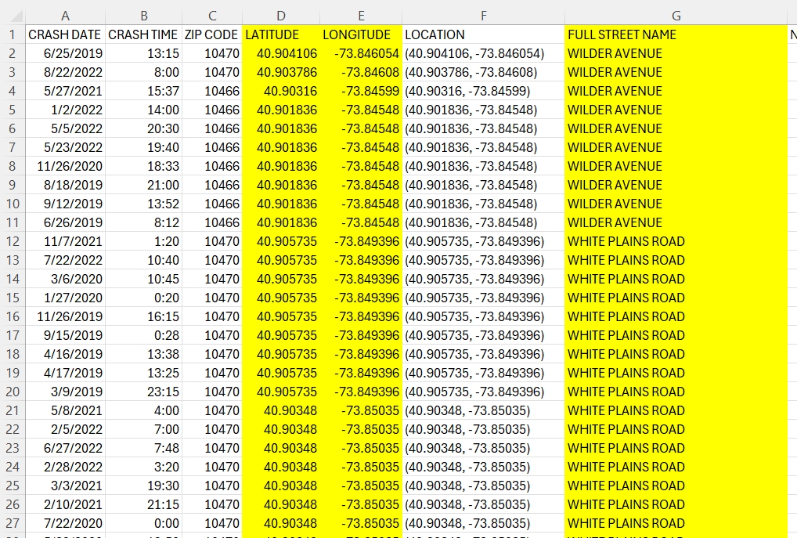
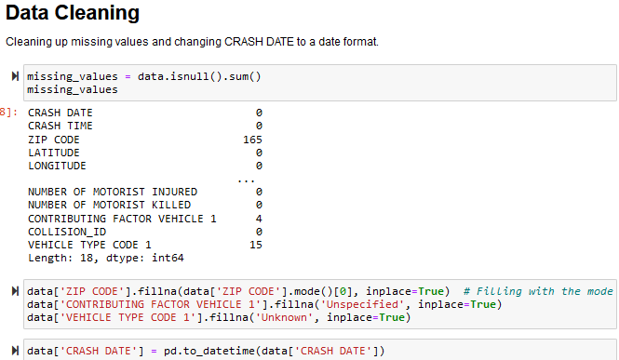
Data Processing
New York City, known for its bustling traffic and dense population, faces significant challenges in ensuring the safety of its road users. Despite ongoing efforts to improve road safety, traffic accidents continue to result in substantial injuries and fatalities each year. This project visualizes detailed traffic collision data to identify patterns and trends in accident occurrences.
The goal is to enhance road safety measures, reduce accident rates, and inform policy decisions that could protect the lives of city residents and visitors alike.

Slide 5
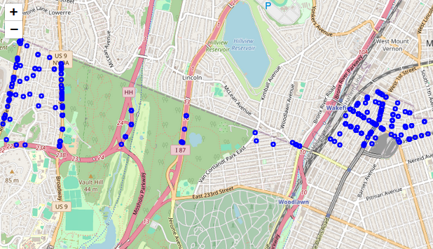
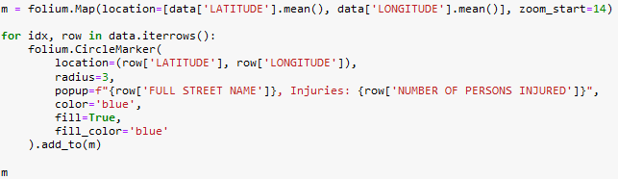
Map Visalization
A plot of collision locations on a map to visually inspect where most incidents occur.
Enhanced Street Lighting and Signage
Traffic Flow Improvements

Slide 6
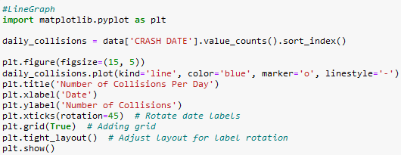
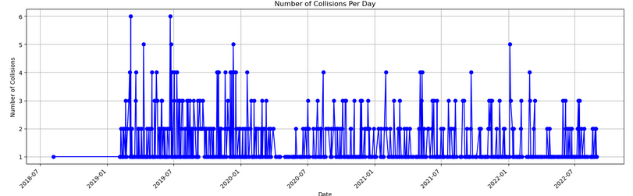
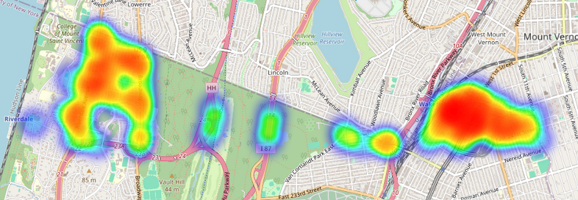
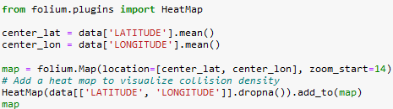
Map Aggregation
Suggested Interventions:
Enhanced Street Lighting and Signage
Traffic Flow Improvements
Public Awareness Campaigns
Increased Enforcement

Slide 7
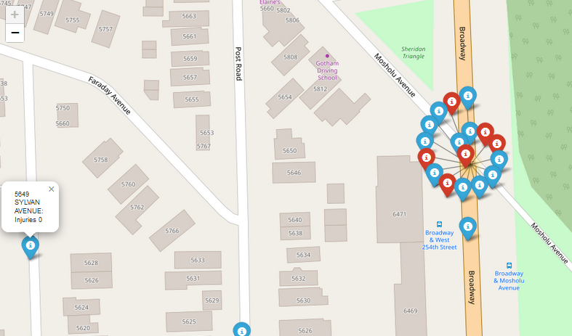
MARKER CLUSTER
INTERACTIVE MAPS
Visualized an interactive map using Folium, allowing us to explore different areas and see detailed information about the collisions.
Collision locations plotted as circles (size = number of injuries)
Popups displaying location, injuries, and other details
Ability to explore different areas, zoom in/out

Slide 8
CONCLUSION
Based on the findings from the temporal and spatial analyses, here are potential interventions:
In areas and times identified with high collision rates, improving street lighting and clearer signage can help reduce accidents, especially during evening or early morning hours when visibility might be poor.
In high-collision areas, reevaluating traffic light timing, adding roundabouts, or redesigning intersections might reduce bottlenecks and collision points.
Focused on times and locations of high risk, these campaigns could educate drivers about potential dangers and encourage safer driving practices.
Targeting enforcement efforts (like speed traps or DUI checkpoints) during peak times for accidents could deter risky behavior.

